Slide 1
Zero-Dimensional Nanostructures: Nanoparticles
Principles of homogeneous nucleation

Slide 2
Solidification
Solidification of metals and alloys usually represents a transformation from a non-crystalline liquid to a crystalline solid.
If a liquid metal is cooled below its equilibrium melting point, T_{m} , the system can lower its free energy ( G = H- T S ) by forming a solid phase.

Slide 3
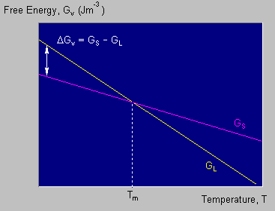

Slide 4
The change in free energy for solidification, ΔG_{v} = G_{S} - G_{L} , or
ΔG_{v} = ΔH_{v} - T ΔS_{v} (1)
where ΔH_{v} and ΔS_{v} are the changes in enthalpy and entropy.
At the equilibrium melting temperature, T_{m}, the driving force for transformation, ΔG_{v} = ?
ΔH_{v} - T_{m} ΔS_{v} = 0
ΔS_{v} = ΔH_{v} / T_{m}
Substituting this expression for ΔS_{v} into Equation (1):
ΔG_{v} = ΔH_{v} - ( T ΔH_{v} / T_{m} )
= ΔH_{v} (1 - T / T_{m} )
= ΔH_{v} (T_{m} - T) / T_{m}
But T_{m} - T = ΔT, the undercooling, and so we have:
ΔG_{v} = ΔH_{v} ΔT / T_{m}

Slide 5
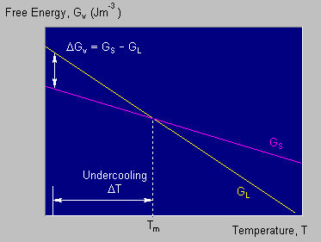
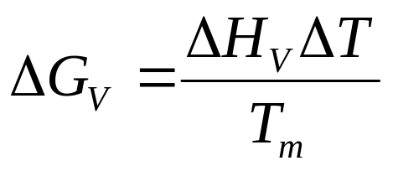
This energy change is the driving force for solidification.
Although solidification cannot occur without a thermodynamic driving force, the rate (kinetics) cannot be predicted from this alone.

Slide 6
Principles of phase transformation
Nucleation:
  The physical process by which a new phase is produced in a material. In the case of solidification, this refers to the formation of a tiny, stable solid particles in the liquid.
Growth:
  The pysical process by which a new phase increases in size. In the case of solidification, this refers to the formation of a stable solid as the liquid freezes.

Slide 7
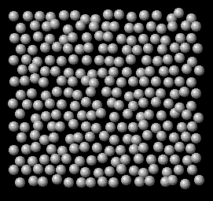
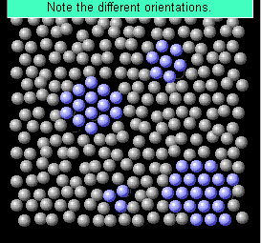
Nucleation is the initial stage of formation of one phase from another phase (L o S)
When a liquid metal is cooled towards the melting temperature, some atoms are already beginning to randomly arrange themselves into small crystal-like clusters.
The formation of such clusters arises from the random motion of the atoms within the liquid.
The average cluster size increases as the temperature falls below T_{m}.

Slide 8
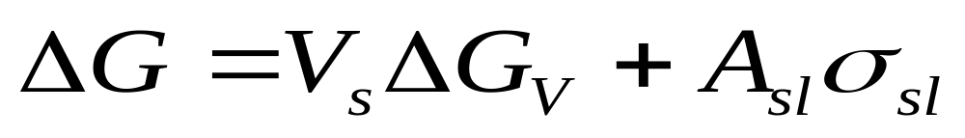
When the cluster form we have:
Volume Free Energy Change
+
Surface Free Energy Change
Total Free Energy Change

Slide 9
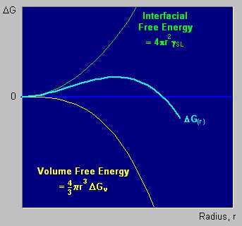
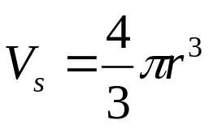
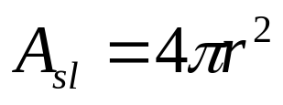
Assuming the interfacial free energy is isotropic, the cluster will grow spherically.

Slide 10
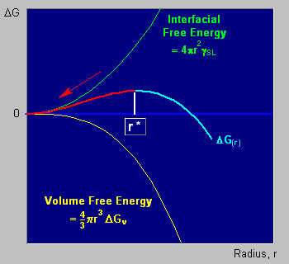
R_{embryo} < r*
Free energy increase.
The solid remelts,

Slide 11
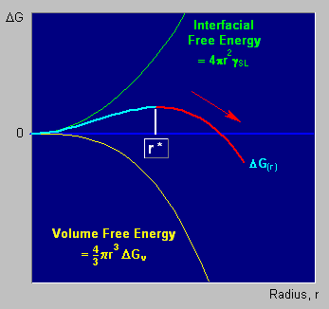
R_{embryo} > r*
The solid will grow,
free energy decrease.

Slide 12
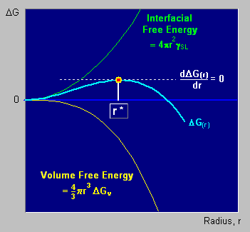
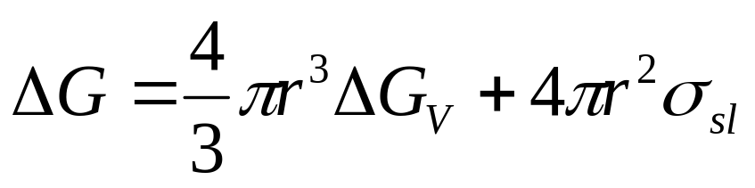
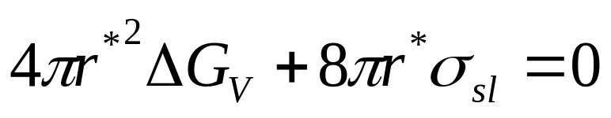
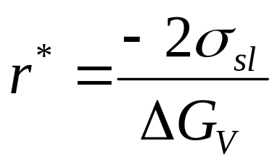
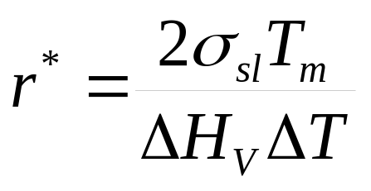
r* to Homogeneous Nucleation

Slide 13
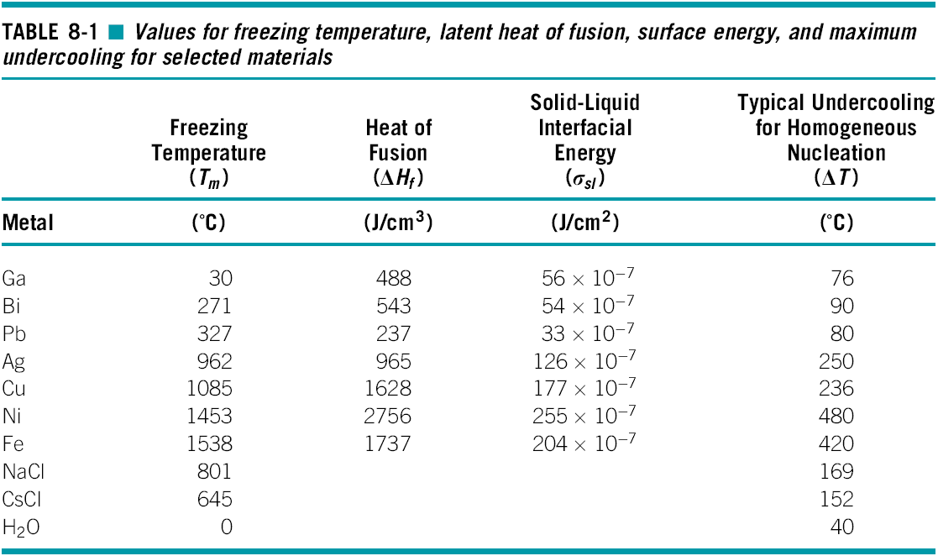

Slide 14
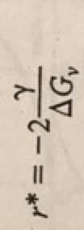
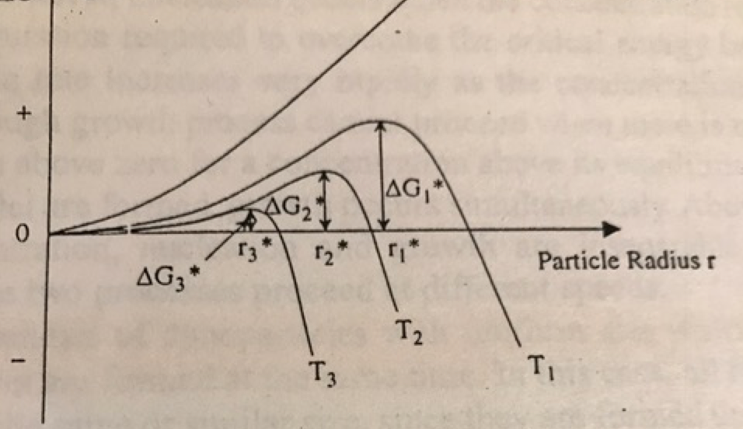
Is it possible to reduce the r*
The free energy is a function of T and supersaturation (C-Co)/Co
However…
the supersaturation decreases as T increases
the surface tension ________ as T increases

Slide 15
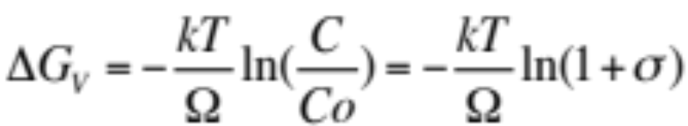

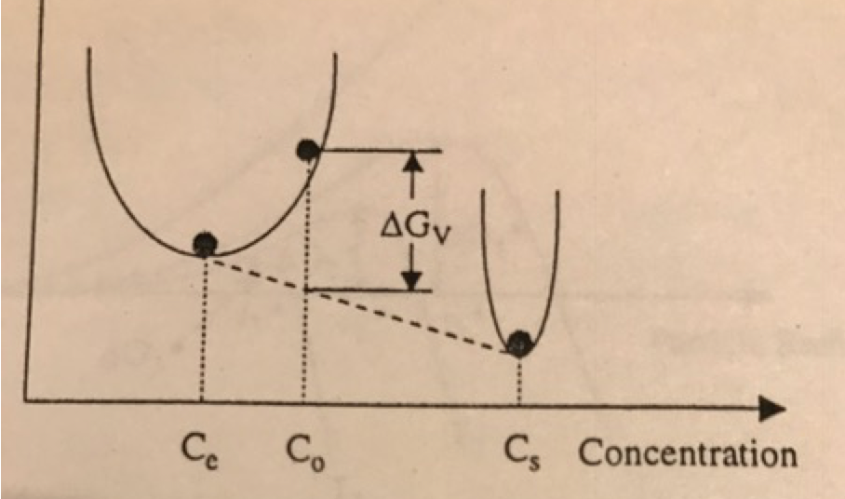

Thermodynamic Approach
Atomic volume
= (C-Co)/Co

Slide 16
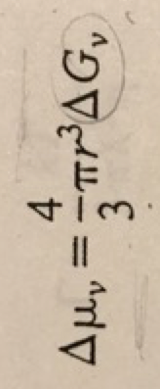
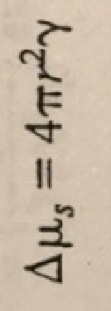
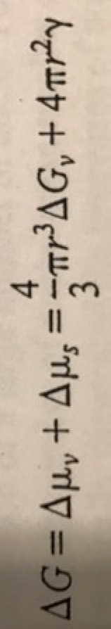
Thermodynamic Approach
Atomic volume
= (C-Co)/Co
Assuming a spherical particle, the change in volume energy is
and the change in surface energy is
the total change of chemical potential

Slide 17
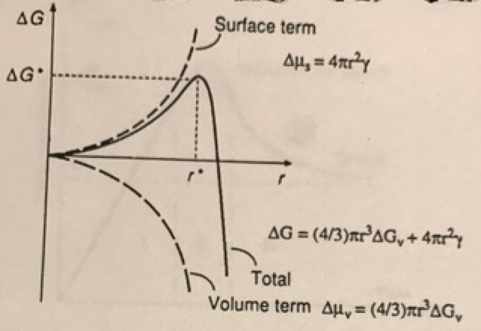
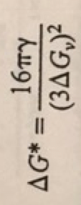

Slide 18
Important considerations
Identical size
Identical shape or morphology
Identical chemical composition and crystal structure
Individually disperse or monodispersed

Slide 19
For the
Feb 18th, 2019 class

Slide 20
Debate…
Based on the information provided so far…
Depict a process to get small particles with the narrowest size distribution possible

Slide 21
Synthesis Methods
Thermodynamic approach
  supersaturation
  nucleation
  growth
Kinetic approach

Slide 22
Desirable features
Uniform size distribution
Identical shape or morphology
Identical chemical composition and crystal structure
Individually dispersed

Slide 23
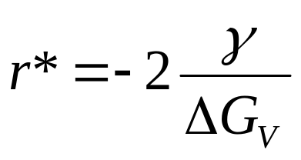
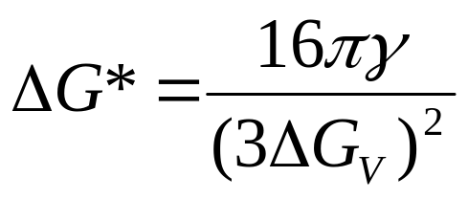
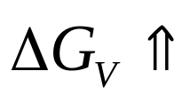
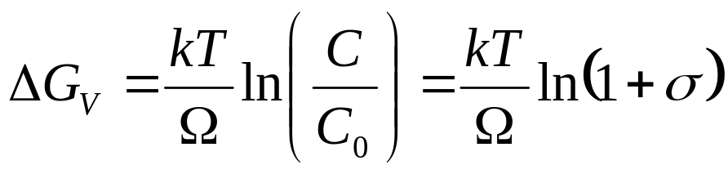


Critical size (r*)
How to reduce the value of r* ?
Energy barrier to overcome, so nulceation can start
so
but remember that…
It affects
surface energy
(specially near roughening temperature)

Slide 24
Other variables affecting r*
Besides of C and T:
Solvent type (polarity)
Additives (i.e.: viscosity)
Impurities

Slide 25
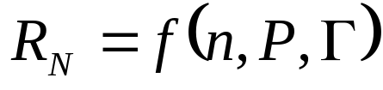
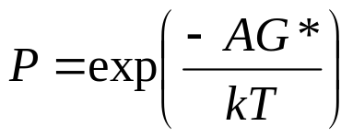
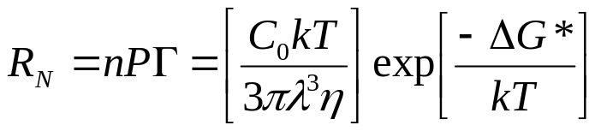
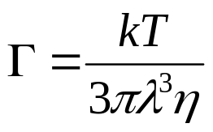
Rate of nucleation (RN)
n is the number of growth species/volume
P is the probability of fluctuations of the critical free energy ΔG*
Γ is the frecuency of species jumping from one growing site to another one

Slide 26
below C_{min}
nucleation ceases, so…
C_{max}
nucleation & growth
C_{min}
Solute Concentration
only growth
C_{s}
time

Slide 27
Growth of the nulcei
Steps:
generation of the species
diffusion from the bulk to the surface
adsorption onto the growth surface
surface growth onto the solid surface
diffusion limited
growth limited

Slide 28
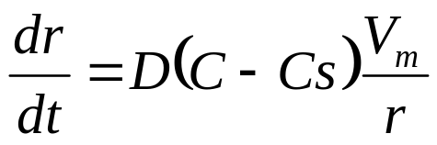

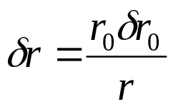

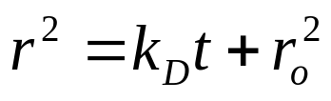
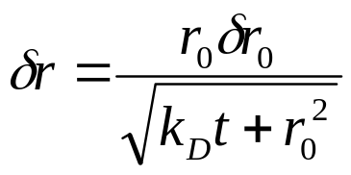
Diffusion controlled growth
Promotes the formation of uniformly sized particles
For this type of growth
the radius difference
among particles is given by:
D is the diffusion coefficient
r δr = r_{o} δr_{o}
at time t=0, r = r_{o}
Therefore such difference decreases with time as well as
with higher values of r_{o} and
higher k_{D}
where: k_{D}=2D(C-C_{s})V_{m}
is the diffusion constant

Slide 29
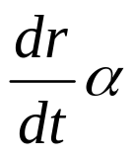
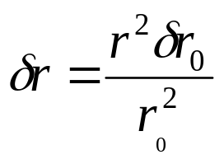
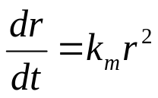
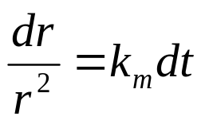
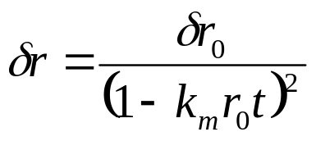
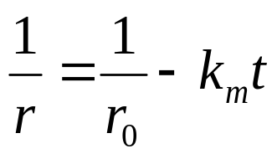
Surface controlled growth
Does not promote the formation of uniformly sized particles
Monolayered
If the radius of the nulcei increases,
then the radius difference among
particles increases:
surface area
δr/r² = δr_{o} /r_{o}²
substitution of r:
therefore:
as t increases…

Slide 30

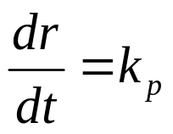
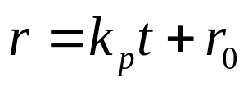

Surface controlled growth
Does not promote the formation of uniformly sized particles
Polinuclear growth
surface process is very fast,
growth rate is constant
Growth controlled by surface process:
monolayer growth
r
Growth controlled by surface process:
polynucler growth
Therofore, the radius difference remains constant:
Growth controlled by diffusion

Slide 31
Advantages of solution processes
It is easy to:
prevent agglomeration
extract
do surface modifications and applications
control the process
have mass production

